Slide 1
Announcements
International Day Fair/ Talent Show is Friday, April 23rd from 1-3:30
Monday, April 26th is the Last Day to Withdraw from ACC classes. Please speak with Mr. Gordon or Mr. Longoria before withdrawing.
Prom is May 1st 7-10 PM at McKinney Roughs for Juniors and Seniors. Tickets are now on sale. $35 for CRCA students and $40 for guests.

Slide 2

What Do I bring to College?
When applying for college your senior year, even though all of you have college credits, you will be applying and getting admitted as a college freshman.
All universities encourage freshman students to live in the dorm their first year, and many even require it.

Slide 3
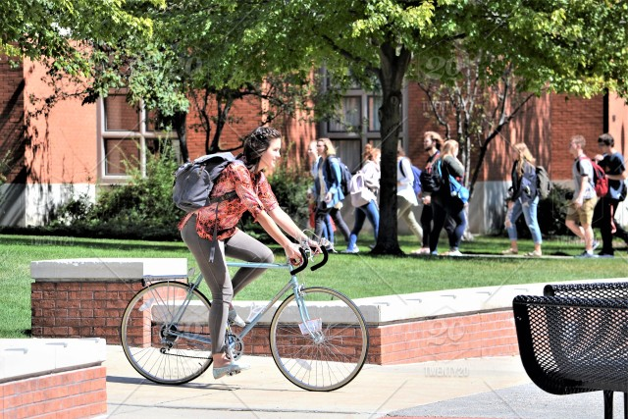


What Do I bring to College?
Every student is different depending on how far your university is from home and how big your campus is, but here are a few suggestions.
Three Major (most expensive) Items:
1. Car
2. Bike
3. Laptop
Get this one if possible

Slide 4
What Do I bring to College?
Other Items:
Sheets/ Pillows/ Blanket
Towels
Mini Fridge (check with school before purchasing)
Microwave (check with school before purchasing)
Room Decorations
Coffee Maker
Kitchen Supplies
Photo ID/ Car Insurance and registration

Slide 5
What Do I bring to College?
For a full list, you can go here:
https://bigfuture.collegeboard.org/get-in/making-a-decision/off-to-college-checklist
Many of you (especially current Juniors) can start purchasing these items now or asking for them for Christmas or birthdays, so you can save more cash the summer before leaving for college.

